Slide 1
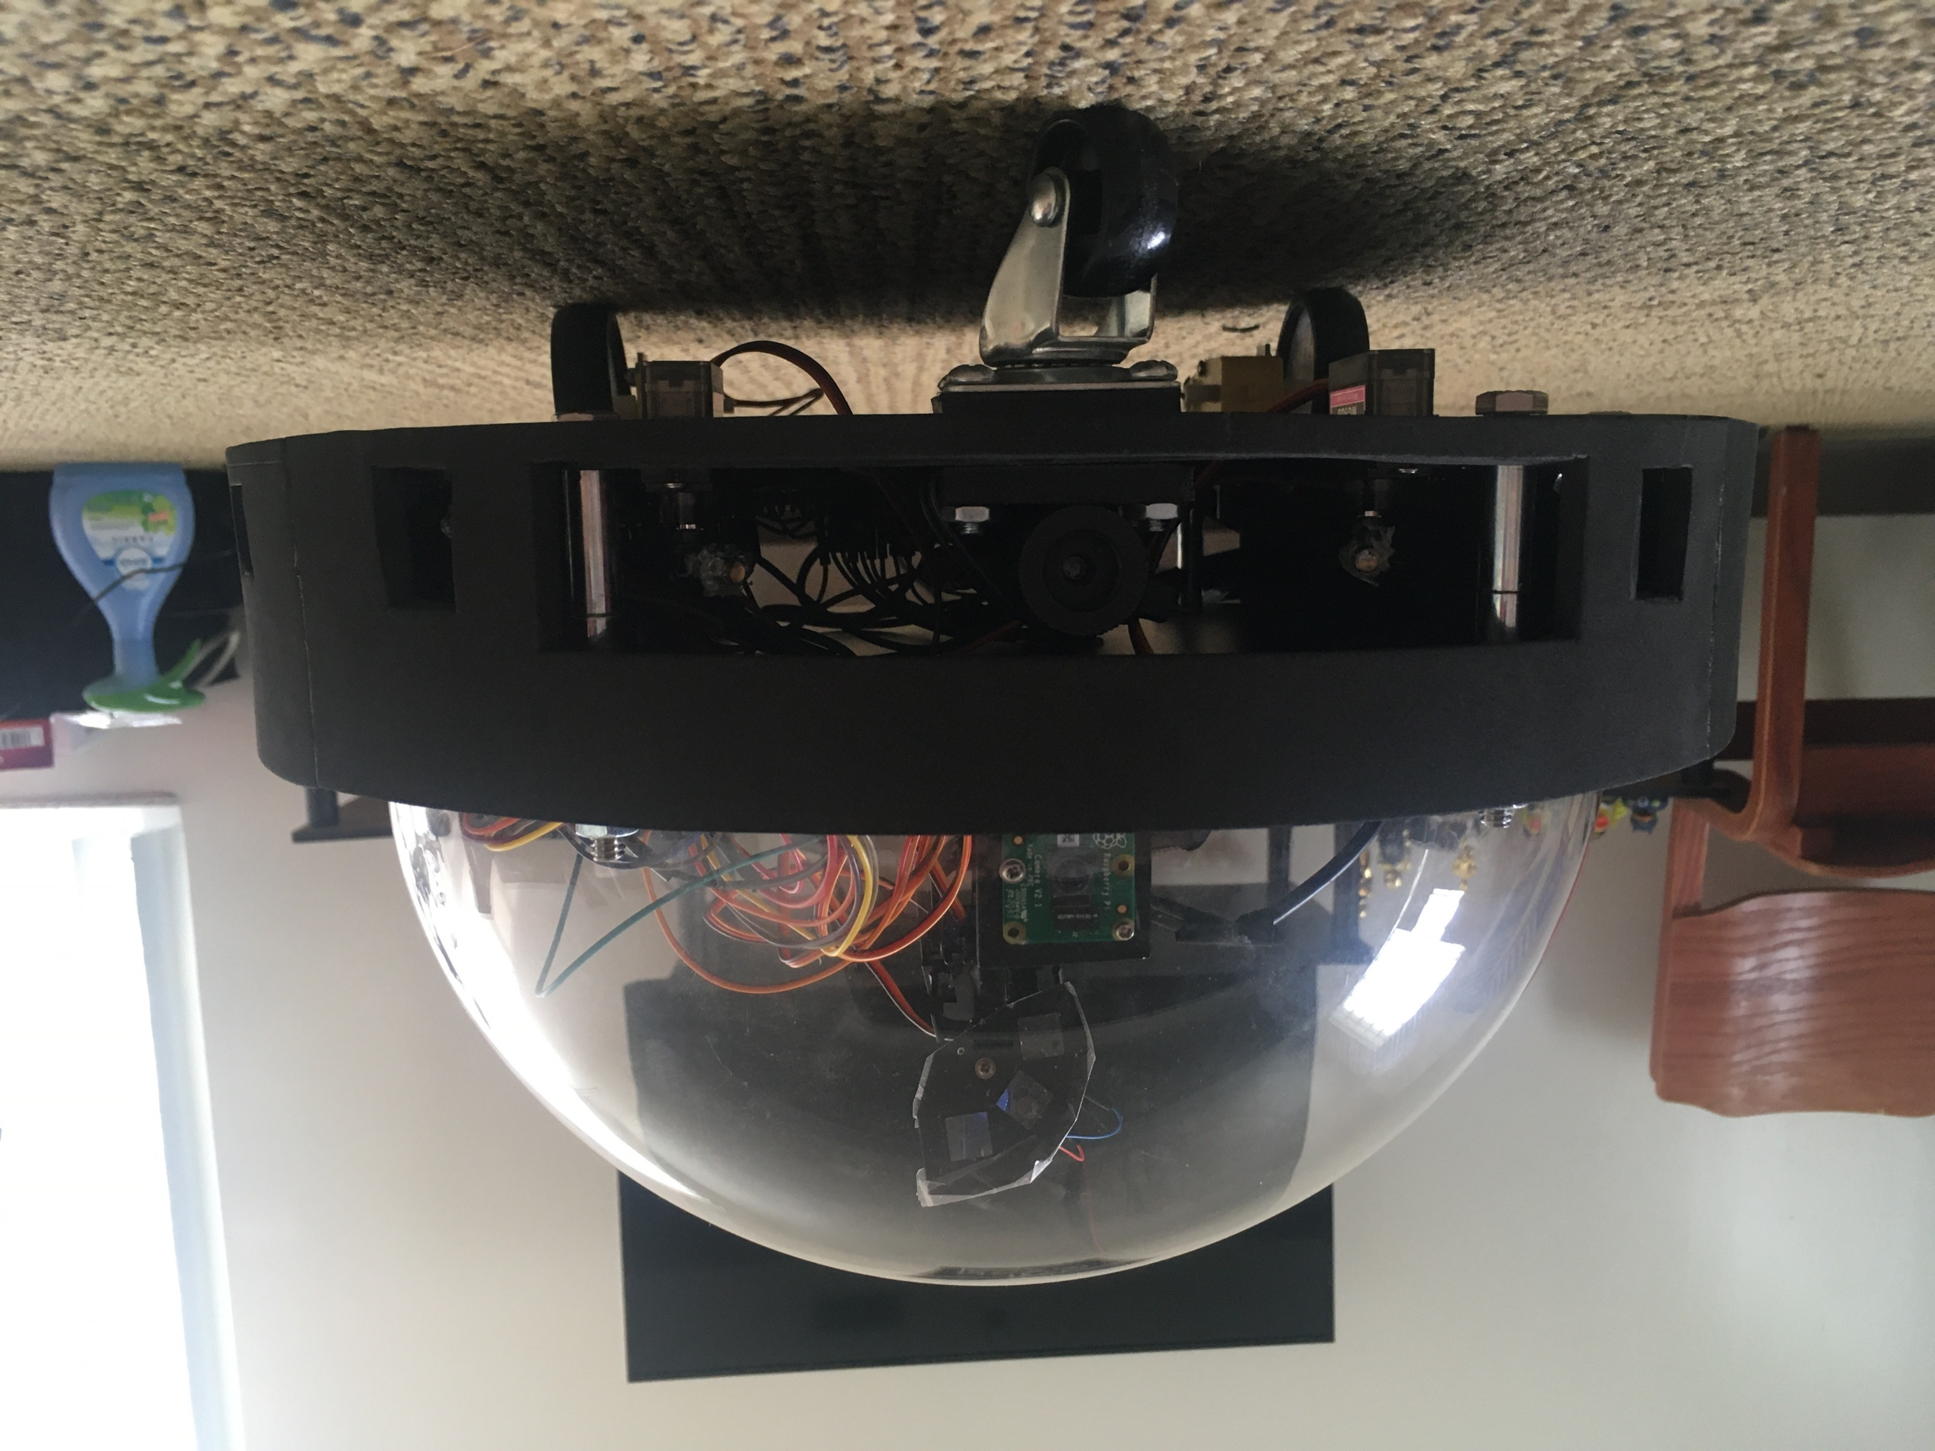
Autonomous Pet Entertainment System (A.P.E.S.)
Nathan Anthony (EE)
Cameron Alexander (CpE)
Ricardo Serrano (PSE)
Group 8
Naim El-Nil (PSE)
Notes:
we are group 8 and our project is the Autonomous pet entertainment system or APES

Slide 2
Motivation
We’re all home a lot now
Still have other obligations
Pets still want attention
Nathan Anthony (EE)
Notes:
Everyone likes to play with their pets when they’re at home. But there are times when you really need to get something done and just don’t have time to spare entertaining them. Especially these days with many people working virtually from home, our furry friends expect a lot of attention from us while we’re stuck in staff meetings. This is where the APES comes into play.

Slide 3
Description
Specifications
Specification | Value | Unit
Speed | 1.5 | fps
Obstacle Distance | 6 | in
Radius | 13.5 | in
Height (peak) | 10.375 | in
Cost | 366.30 | $
Laser Rangefinder Detection Range | 3-40 | in
Automated Laser Pointer
Roams the room
Plays with pets
6”
10.375”
2”
13.5”
Nathan Anthony (EE)
Notes:
The APES is designed to offer dynamic entertainment for pets without you needing to do more than just turn it on. The APES will be able to see your pet with an onboard camera and actively keep a laser pointer away from it as well as be able to move itself around a room while avoiding obstacles using a laser rangefinder and multiple IR sensors. It will have a similar speed and radius to a Roomba with a clear dome on top. The infrared sensors will detect objects at about 6 inches away to begin breaking and the entire project was constructed under our budget of $600.

Slide 4
Operation overview
Two modes of operation
Mode 1: Tracking/Laser Display
Mode 2: Navigation
Autonomously switches between modes
Cameron Alexander (CpE)
Notes:
The APES is an autonomous robot with two modes of operation
Mode 1 is scanning
Mode 2 is movement
The Apes is capable of switching between modes automatically

Slide 5
Operation overview - tracking/Display
After powering on APES scans the room for the subject
If the subject is detected it displays the show laser
It will attempt to keep the laser away from the subject
If the subject is not found it will switch to navigation
Cameron Alexander (CpE)
Notes:
The APES begin in mode 1 and scans the room for subject
If the subject is detected it will display the show laser
it will attempt to keep the show laser away from the subject

Slide 6
Operation overview - Navigation
The APES will navigate its environment to find a new area to scan for the subject
It will use sensory inputs to avoid collision with obstacles
After time has passed it will switch modes again and attempt another scan for the subject
Cameron Alexander (CpE)
Notes:
If the apes is unable to detect the subject it goes into mode 2
in mode 2 the APES will attempt to navigate its environment
It will take in input from sensors determine any obstacles in its path and navigate away from them
during both modes it will observe its orientation and shut off if knocked over
***ADD***
We have programmed the show laser to be off any time that the APES is in movement. This was done because navigation is when the toy is most likely to become inverted, potentially pointing the laser upward. The size and weight distribution of the APES also helps to mitigate the potential for flippling

Slide 7
Controller selection
Jetson Nano
Camera
All (6) Servos
Laser Rangefinder
Main Control Signal
ATMEGA328
Show Laser Power
Navigation Control
Propulsion
All (4) IR Sensors
Nathan Anthony (EE)
Notes:
In order to facilitate the device’s operations, we decided on using two different controllers in tandem: the Jetson Nano and ATMEGA328.
The jetson was tasked with camera control and processing, controlling all six servos, powering the laser rangefinder and processing its results, and determining the operation mode of the APES.
The ATMEGA328 controls the power to the show laser, runs the navigation algorithm with the signal from the jetson, controls all propulsion and reads the output from the IR sensors

Slide 8
Labor division
Team Member | Show Laser | Sensing | Movement | Camera | Code/Algorithms
Nathan |  | S | P |  | S
Naim | P | CP | S |  | S
Cameron |  | S | CP | P | P
Ricardo | CP | P | S |  | S
Key: P = Primary Contributor CP = Co-Primary Contributor S = Secondary Contributor
Ricardo Serrano (PSE)

Slide 9
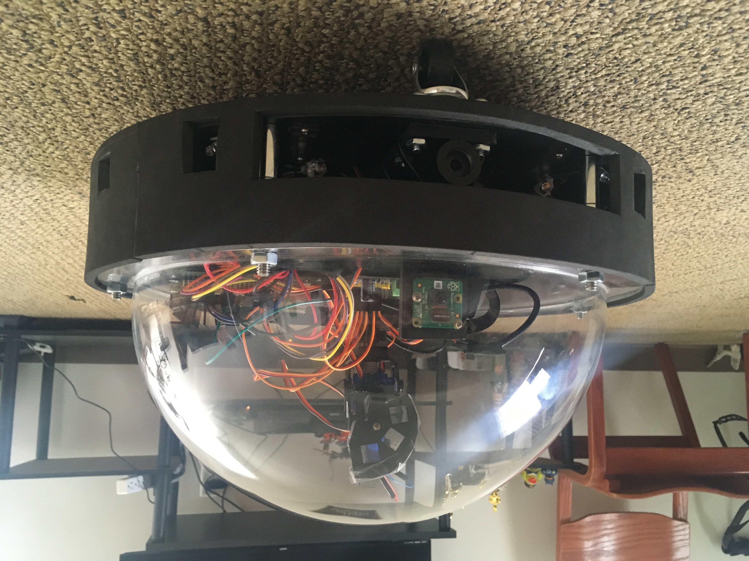
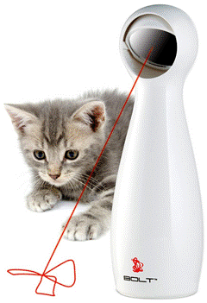
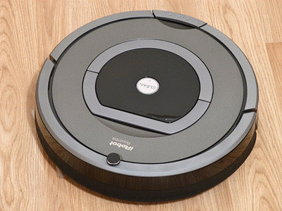
Design
A.P.E.S.
Nathan Anthony (EE)
Notes:
Now moving on to some of the design aspects of the APES. Many of these were inspired by existing robot vacuum cleaners and automatic cat toys.

Slide 10
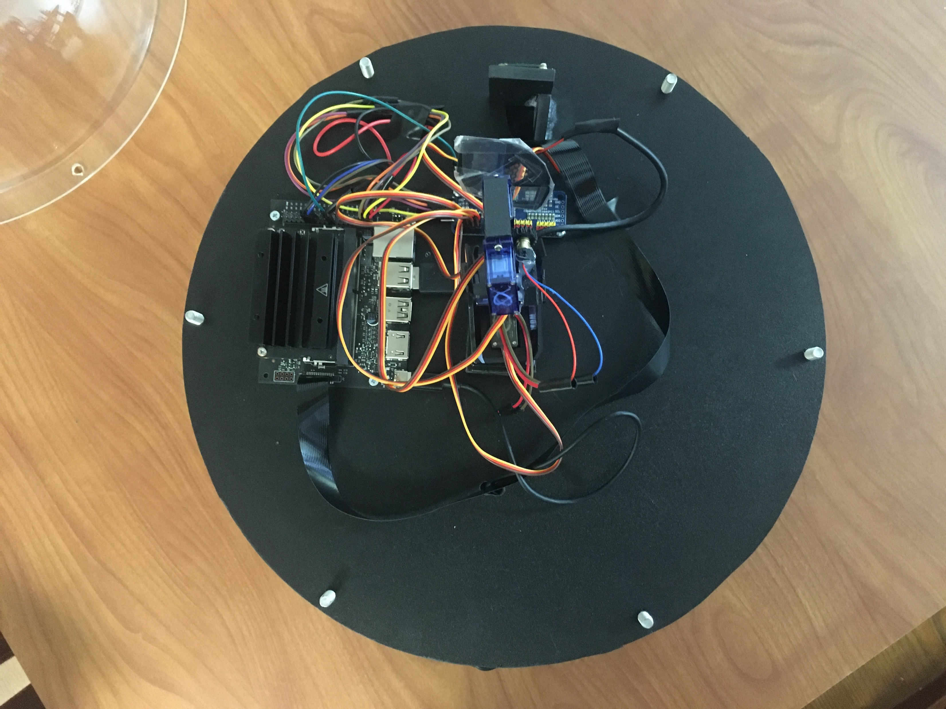
Chassis materials
Acrylic
Expanded PVC Foam Board
EVA Foam
Nathan Anthony (EE)
Notes:
The chassis was constructed with weight and durability in mind. The two sheets that make up the main component cavity are cut from quarter inch expanded PVC foam board which is a thermoplastic that is lighter and more durable than wood of the same size. The dome of the APES is made of clear acrylic. Surrounding the main cavity is 3mm EVA foam which is intended to protect both the APES and any potential obstacles from harm in the event of a collision.

Slide 11
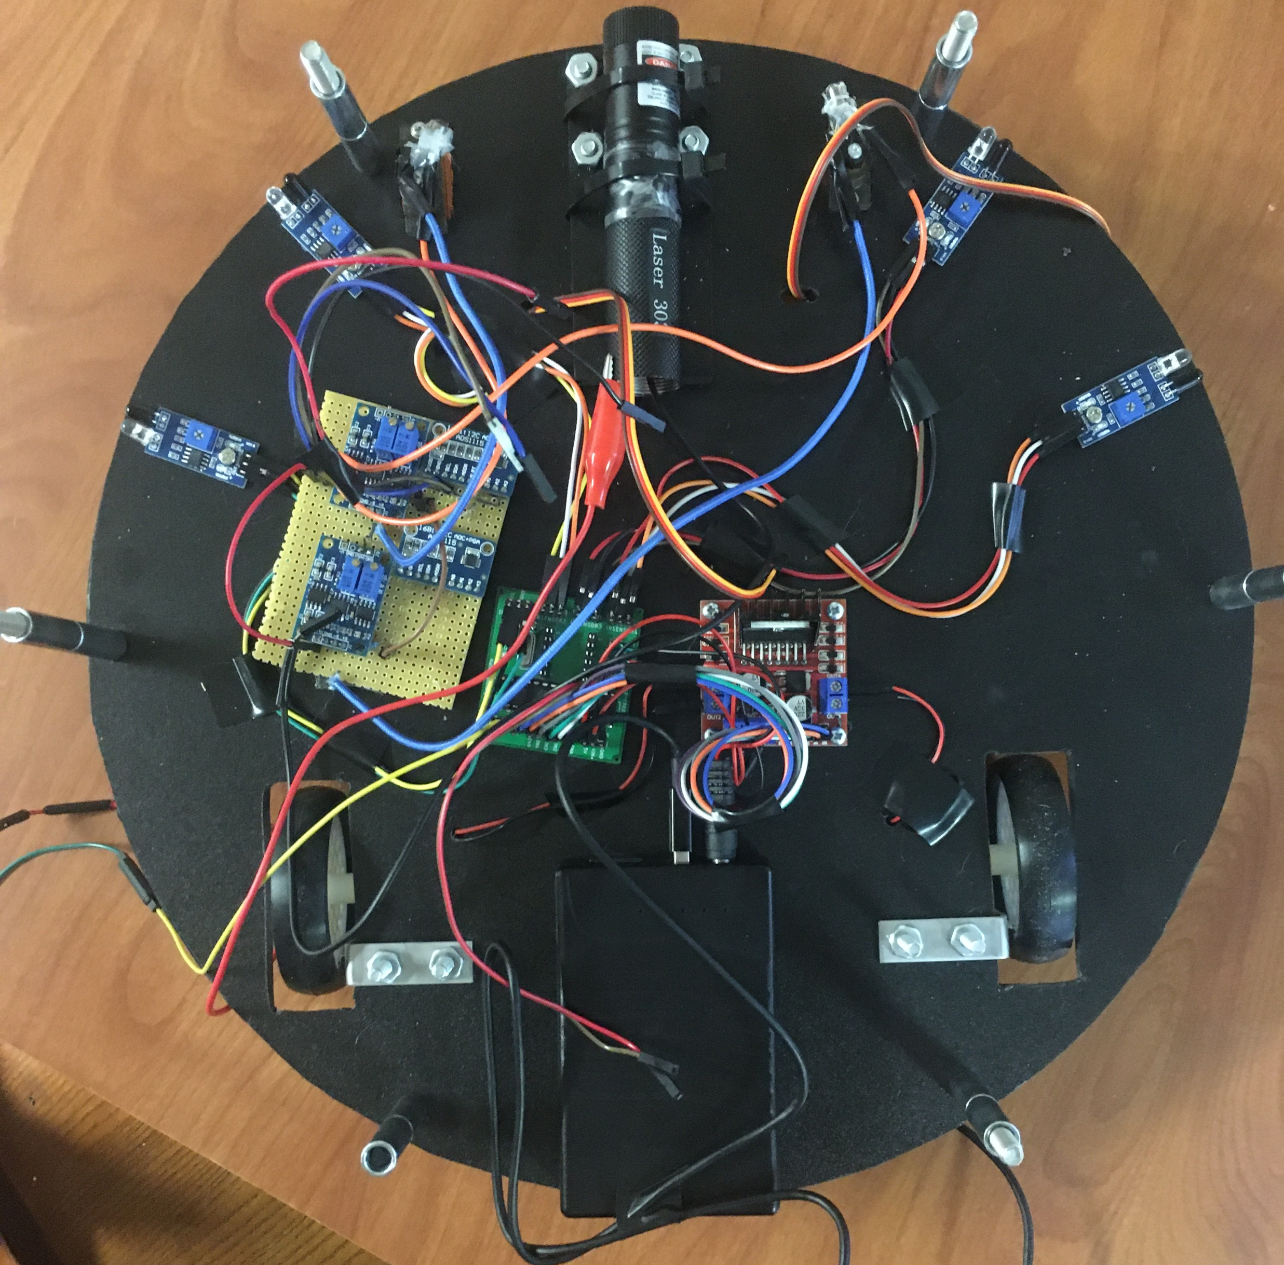
Propulsion
Underside
Main Cavity
Caster
Motor Driver
PCB
Drive Motors
Battery
Nathan Anthony (EE)
Notes:
The APES uses the three wheeled design shown on the left with two, fixed drive wheels that operate independently. The front wheel is a free spinning caster. This arrangement allows for minimal complexity, zero-radius turns, and a wide, stable base on which to mount the various other components. The rest of the subsystem is contained in the main cavity of the device shown on the right. This includes The printed circuit board containing the ATMEGA328, the motor driver, and battery.

Slide 12
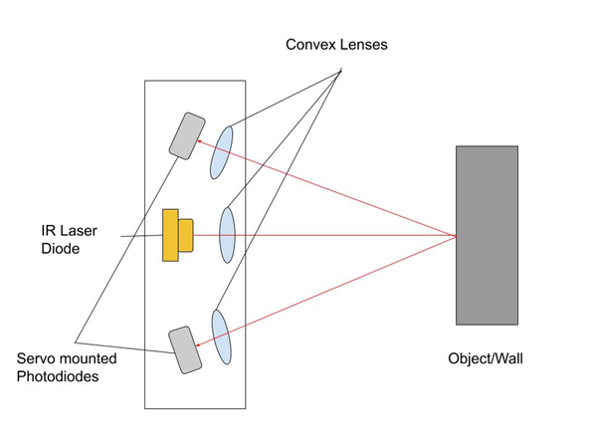
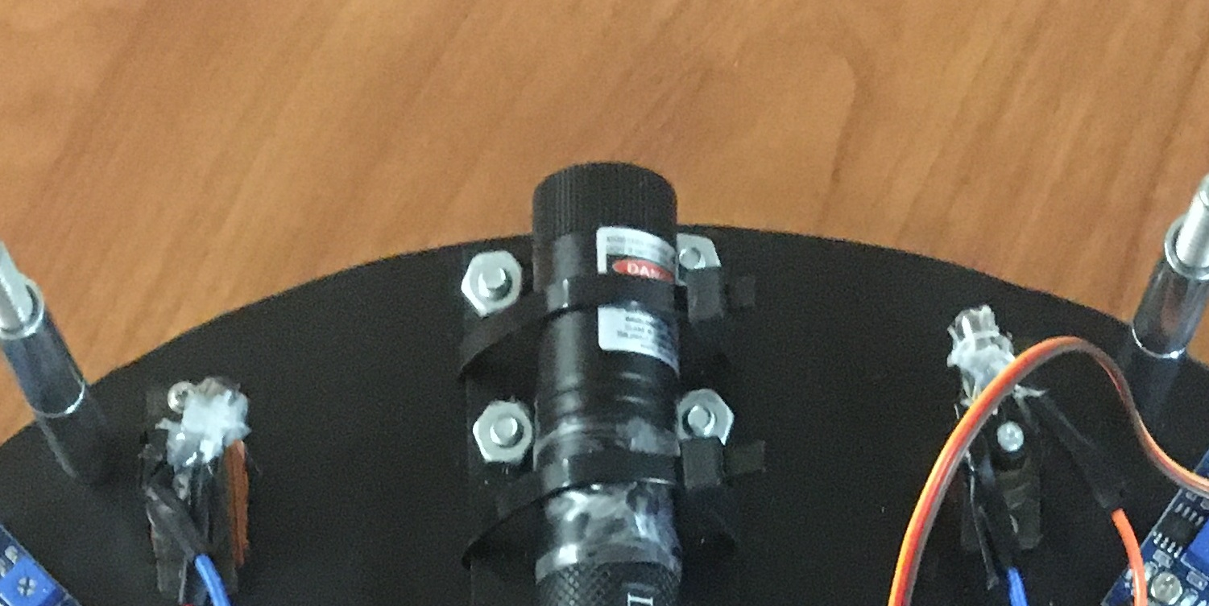
Laser rangefinder Overview
The Rangefinder is the main navigational tool in front of the APES
Uses an IR laser output and photodetectors to find exact distance
5 mW 940 nm Infrared laser used
Both Photodiodes (sensitive to 940 nm) sweep 45° for each measurement
Ricardo Serrano (PSE)
Notes:
Last sentence and add picture of final

Slide 13
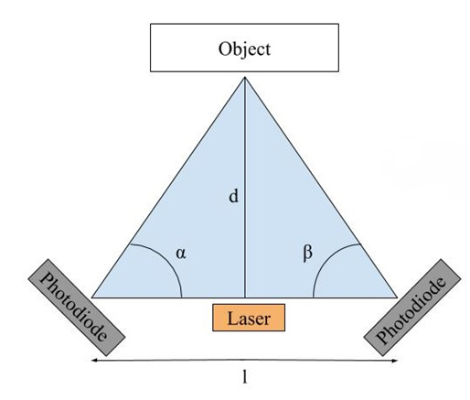
Rangefinder method
After analyzing various methods, Triangulation was chosen
Photodiodes are a fixed distance of 5.5 inches apart
Produces accurate and precise results
Ricardo Serrano (PSE)

Slide 14
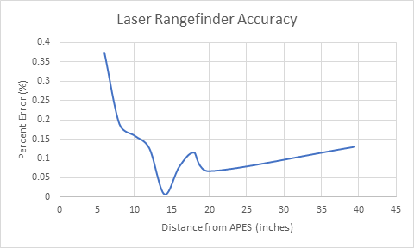
HARDWARE TESTING – Rangefinder Accuracy
Ricardo Serrano (PSE)
Notes:
Last sentence and add picture of final

Slide 15
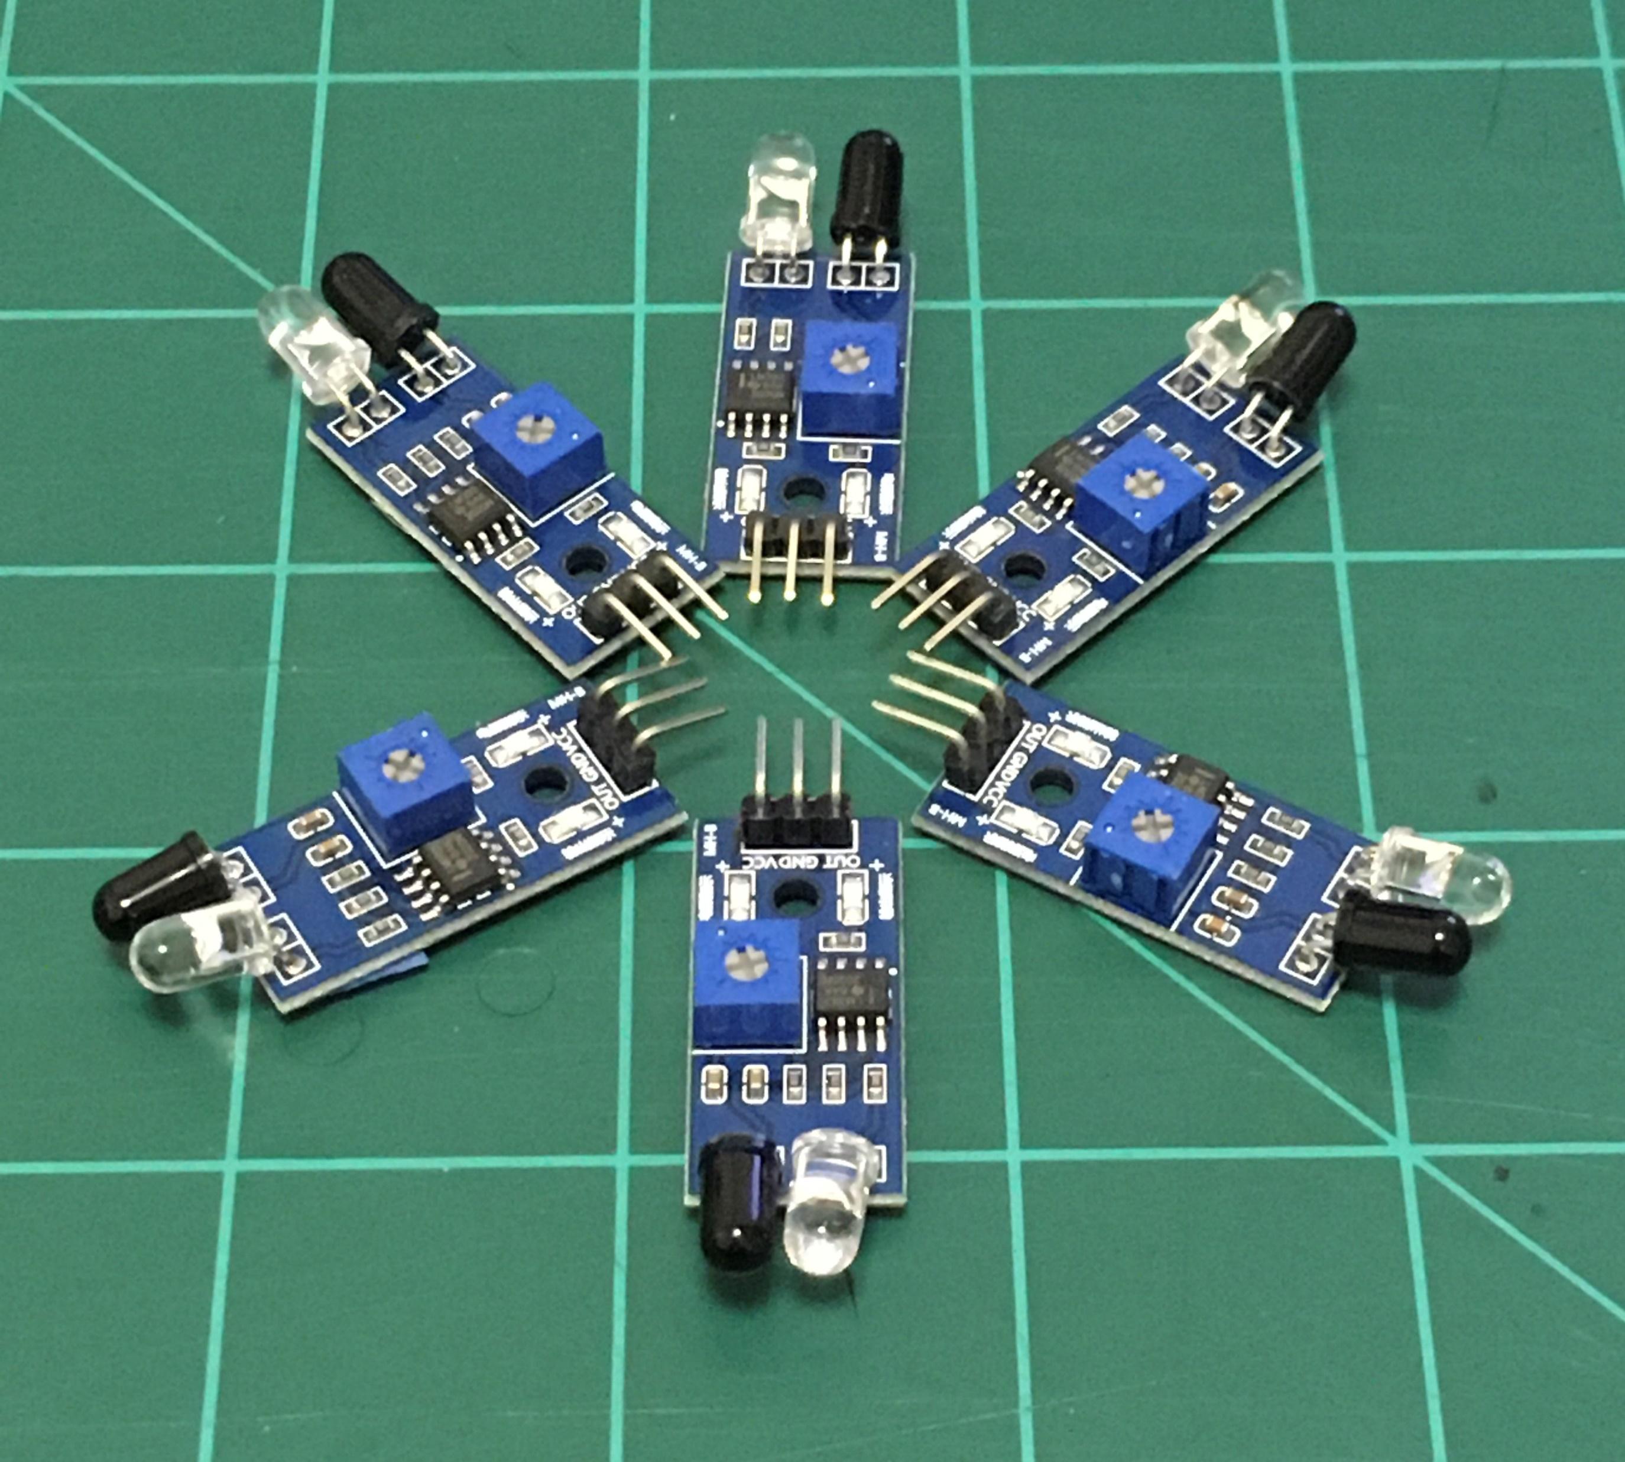
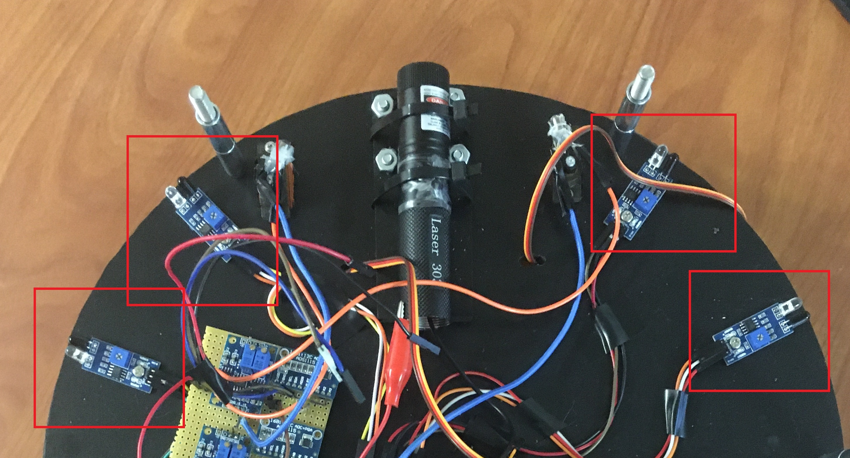
LED IR sensors
Utilized as additional navigation aid to rangefinder
Detects relative range, not exact distance
Each module has an IR LED and paired Photodiode
4 pairs evenly spaced along APES on front sides
Ricardo Serrano (PSE)

Slide 16
Location of Navigational components
Ricardo Serrano (PSE)
Notes:
Camera not on during navigation

Slide 17
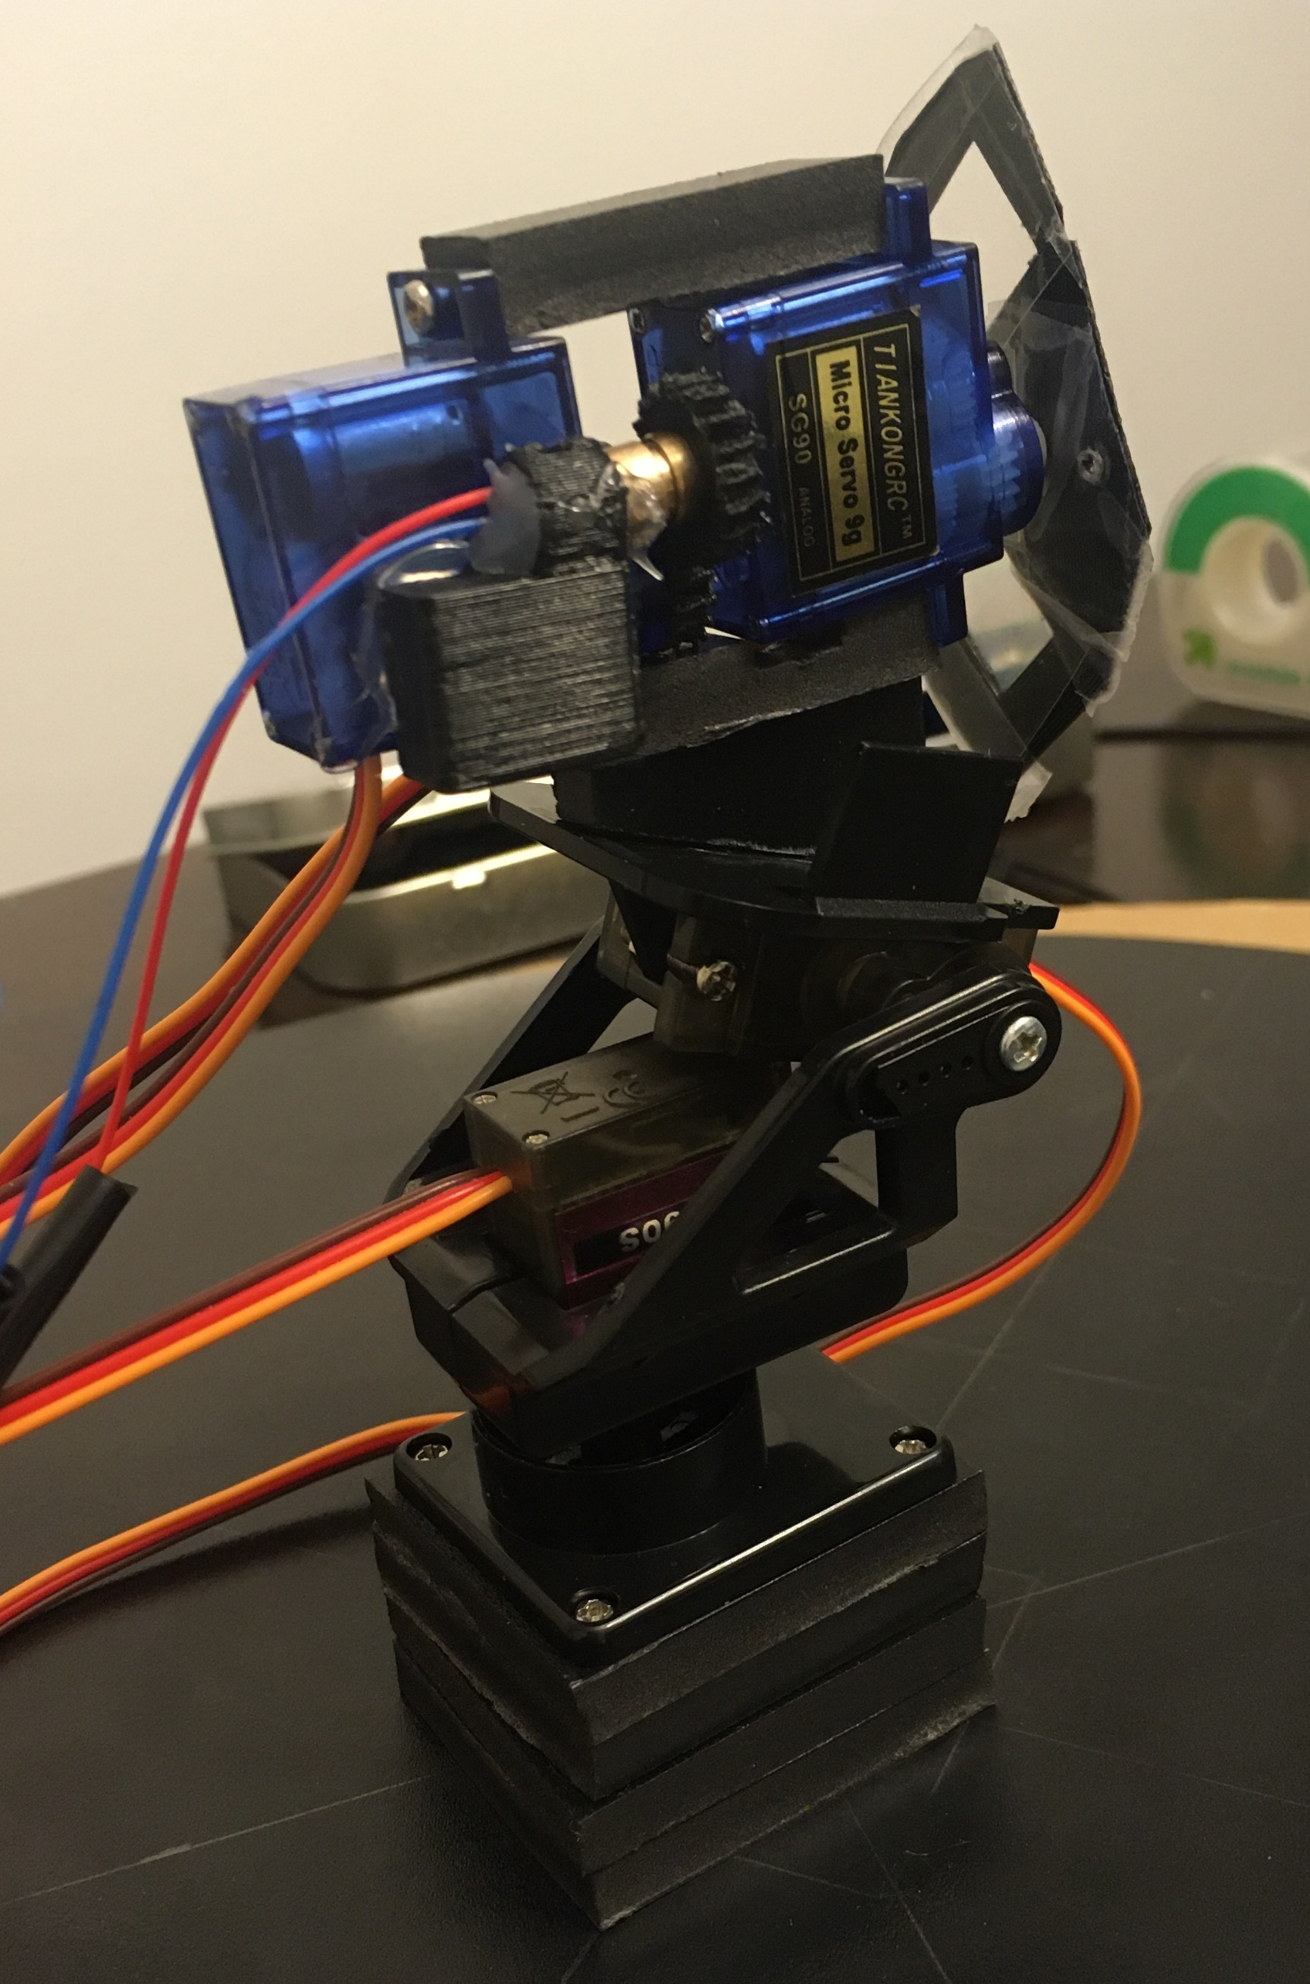
Show Laser overview
Red laser diode
Servos to change magnification
Servos to rotate diffraction grating wheel
Stability and alignment
Attached to Servos Mount for rotation:
180 degrees horizontal; 100 degrees vertical
Show Laser
Naim El-Nil (PSE)
Notes:
The show laser is the subsystem responsible for having a visible output beam that can change shape and size, move in response to a cat's position, and conform to laser safety standards. It is a very compact set-up of a red laser diode, a servos to change the size of the beam, and a servos to rotate between different diffraction gratings one at a time. All the components are stabliized onto two servos: one is for 180 degrees of horizontal rotation and the other is for 100 degrees of vertical rotation.

Slide 18
LASER DIODE comparison
 | Red Laser | Green Laser
Wavelength | 650 nm | 532 nm
Class | 3 (5mW) | 3 (5mW)
Power Consumption (V*I) | 5V*0.31A = 1.55 W | 2.2V*0.2A = 0.44 W
Length | 1.3 cm | 10.5 cm
Naim El-Nil (PSE)
Notes:
In our initial design, we had a green laser as our Laser Diode to give it a more unique color but there has been contraints that prevented it from being used. In this slide we will compare the cost and benefits of switching our laser.
The green laser at 532 nm is higher up on the visibility curve of the human eye than a red 650 nm laser which helps improve its detectability. This is an advantage for the green laser as the diffraction grating orders are usually quite dim.
Both of the lasers were to be operated in class 3 at a maximum of 5 mW which is the brightest possible laser to be considered safe to be around for a human or cat.
The power consumption of the red laser is 1.55 W while the green laser is at 0.44 W which is a noticable difference but this does not affect our design.
The main reason to switch to the red laser was for its size. Its length at 1.3 cm compared to the green laser's length at 10.5 cm drastically reduces its weight and increases its compactness so it can fit on the servos mount with no mechanical errors. We had to redesign every component of the show laser to limit the amount of moving mechanical parts that are prone to error. This is most apparent in our next slide of our lens system.

Slide 19
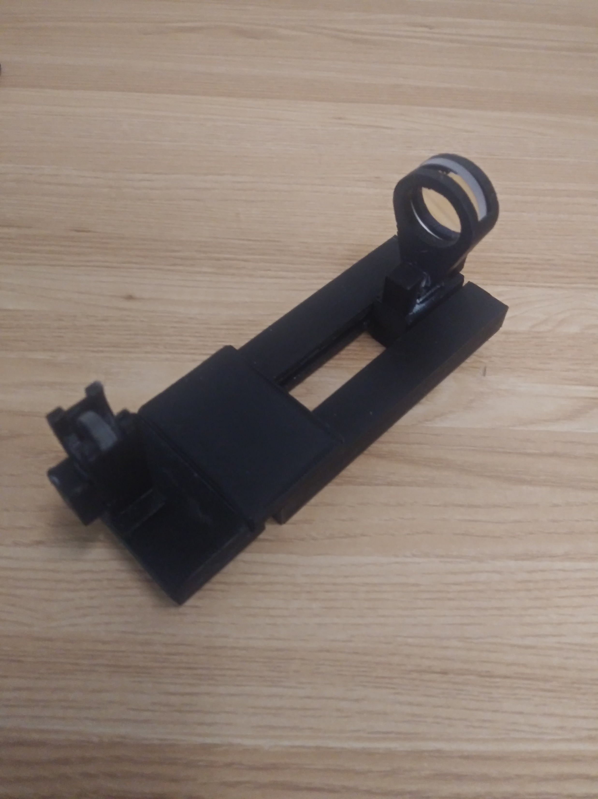
LENS SYSTEM COMPARISON
 | Version 1 Lens System | Version 2 Lens System
Lens 1 Focal Length | 38.1 mm | Collimating (few mm)
Lens 2 Focal Length | -100 mm | N/A
Distance to Screen | Several Meters | 28 inches
Beam Diameter | 5mm; 55 mm; 125 mm | 3 mm; 8 mm
Magnification | 1x; 7x; 21x | 1x; 2.66x
Length | 6.5 inches | 2.5 inches
2.5”
6.5”
V1
V2
Naim El-Nil (PSE)
Notes:
Version 1 of our lens system was shown in our mid-term demo and had fulfilled our main requirements of our optical design which were distinct magnification sizes with relatively low divergence. This however had to be cut from our project due to its bulkiness, having to use stepper motors vs. servos, and requiring much more mechanical design than we anticipated.
Version 1 included lens 1 with a focal length of 38.1 mm, and lens 2 with a focal length of – 100 mm and lens 2 was translated backwards to increase magnification. It displayed a beam diameter a few meters away of 5mm, 55 mm, and 125 mm for 3 distinct mmagnifications of 1x, 7x, and 21x. However its size was 6.5 inches long which is too large and bulky to fit with the servos mount.
Version 2 of our lens system is lightweight, is compatible to work with servoses, and is 2.5 cm long which is small enough to fit with the servos mount but had suffered a reduction in magnification . Version 2 consisted of a servos with a gear to rotate and shift the collimating lens of the laser diode. What this does is change the divergence angle of the beam therefore changing its size at a given distance of 28 inches which is a reasonable distance that the beam is to be projected to. Its beam has two distinct sizes of 3mm and 8mm with 1x and 2.66x magnification respectively. It is to be noted that the magnification did not have to be reduced this greatly. What had occurred is since the servos can only turn 180 degrees, there is only a finite distance the collimating lens can move. To be able to circumvent this, we would have had to understand and assemble appropriate gear ratios which is much more mechanical knowledge than we had anticipated and hence became a time constraint to us.

Slide 20
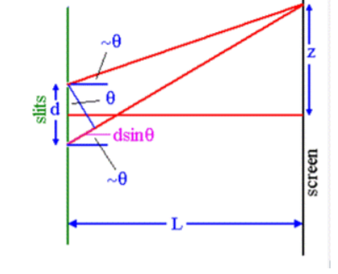
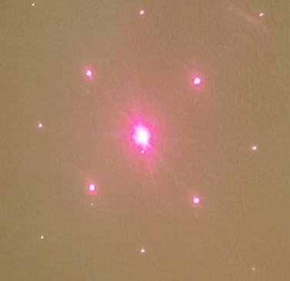
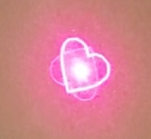
DIFFRACTION grating wheel
Changes shape
Creates 3 unique patterns
Single Axis – 1000 lines/mm
Double Axis – 13500 lines/mm
Unique “Heart-Shaped” Grating
Diffraction Grating Equation:
d sin(θ) = mλ
Small angle approximation sin(θ) = z / L
Single Axis
Heart Shaped
Double Axis
Naim El-Nil (PSE)
Notes:
The purpose of our diffraction grating wheel is to change the shape of the output beam for a unique display of our pet toy. The 3 patterns we will use are the single axis grating at 1000 lines per mm, the double axis grating at 13500 lines per mm and a unique heart-shaped grating. These gratings are palced ono a holder that is connected to a servos to rotate between the gratings one at a time.
The singel axis grating at 1000 lines has its orders diverge greatly due to its low frequency, as in the diffraction grating equation ,the orders distance from the center dot, Z, is inversely proportional to the frequency of the grating. This makes the single axis beam have orders that are very dim and no where near the center dot. Despite its low qulaity we still decided to keep it since it is very similar to a normal dot beam.

Slide 21
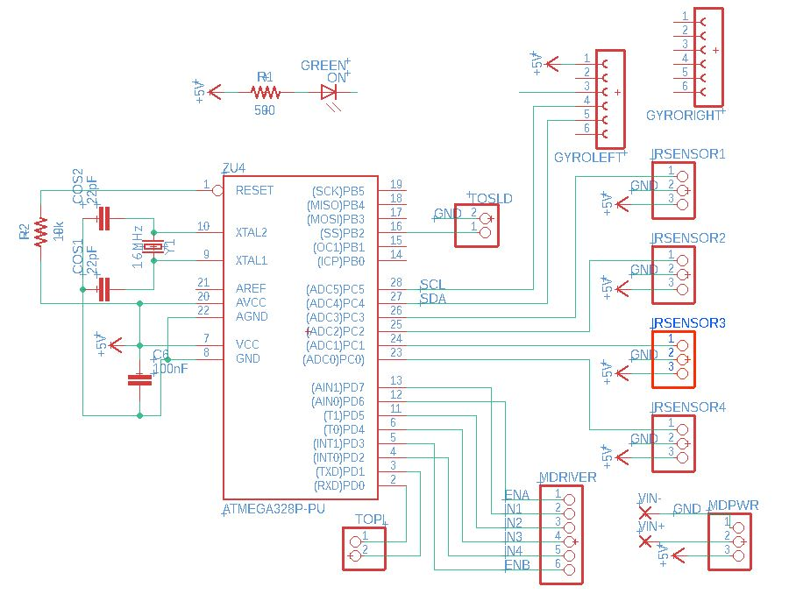
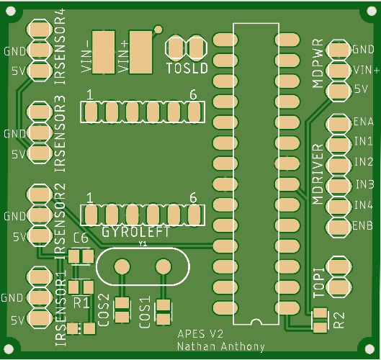
PCB Design
Rendering from JLCPCB
Nathan Anthony (EE)
Notes:
The design of our printed circuit board was created using Autodesk Eagle and manufactured by JLCPCB

Slide 22
PCB Schematic
Nathan Anthony (EE)
Notes:
This PCB acts as a hub for the powering and control over the majority of the sensors and propulsion systems of the APES. These connections are represented by the pin headers highlighted on the schematic. As mentioned earlier, The components connected to the PCB include the four IR sensors, motor driver, show laser, and two communication pins. These components are connected to the board via external wires to allow for ease of positioning within the actual device.

Slide 23
PCB Schematic
Nathan Anthony (EE)
Notes:
Also included on this PCB are a 16MHz crystal oscillator and a resistor tying the 5V power to the reset pin on the ATMEGA. These are necessary components for the ATMEGA’s normal operation. The capacitor tying 5V and ground is protection against power surges and the resistor connected to the reset pin allows the chip to function since the reset pin is active low.
A green LED was included to act as a power indicator for the board and is tied to the 5V rail.
You may notice the absence of a voltage regulator on this schematic

Slide 24
PCB Schematic – voltage regulator work around
PCB
L298N Motor Driver
12V battery
7805 VR
ATMEGA328
5V
Nathan Anthony (EE)
Notes:
The first version of this board did include a voltage regulator designed through the TI webench power designer tool. The website included simulations showing that the regulator would perform as needed for our project, however when we ordered and assembled the board, the voltage regulator did not work. An LT spice simulation of my own showed the same results as the physical circuit so the voltage regulator design was deemed faulty.
Due to time constraints, it was decided that we would use the 7805-voltage regulator on-board the L298N dual H bridge motor driver we were already using. This allowed us to use a 12V battery to power the entire project.

Slide 25
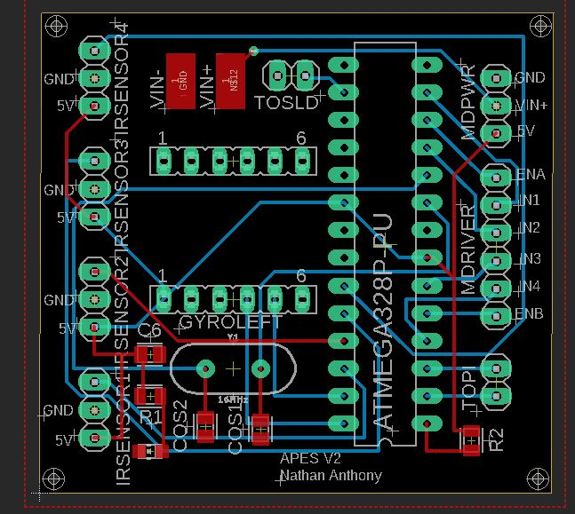
PCB Layout
Rendering from JLCPCB
Nathan Anthony (EE)
Notes:
The use of a top layer ground plane and a 2-layer board allowed for the PCB to be routed to include only a single via. It was manufactured on 1.6 mm standard FR4 with a copper weight of 1 oz.

Slide 26
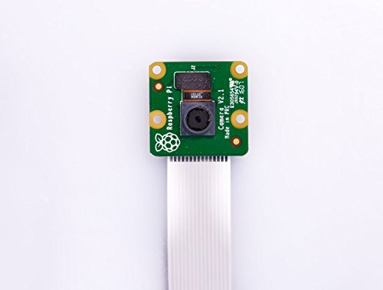
Jetson Nano 2GB and Camera Module
Cameron Alexander (CpE)
Notes:
Pi3B
Primarily used for vision and show laser movement, while also relaying range finder information during movement
Pi is a more powerful than other microcontrollers at a similar price
Allows for us to run complex vision calculations necessary for the APES to meet its design goals
Includes a dedicated camera port that allows for faster video communication between the program and our webcam
Large repository of information regarding other projects with the pi, python libraries for computer vision makes research and implementation easier
RPI-CAM-V2
Camera module specifically designed to be used by the raspberry pi
has special connection directly to the board which allows for faster communication while freeing up space for other peripheral attatchments
60 frames per second at 720p resolution allows for capturing of the data we need to track the motion of the subject

Slide 27
Software Overview - Initialization
Power on device
Check Sensors
Check Communication
Report errors
Cameron Alexander (CpE)
Notes:
Initialization
Power on the device providing power to the microcontrollers
all sensors are checked and communication between the microcontrollers determined to be successful
This allows us to shut down in case any part is malfunctioning so that there are no malfunctions during runtime

Slide 28
Software Overview - Scanning
Driven by the Jetson Nano
Using TensorRT Python Library
Cameron Alexander (CpE)
Notes:
Scanning
Mode 1 is always the first mode initialized
In this mode the ATmega is put to rest and the APES remains stationary except for a hardware interrupt connected to the gyroscope
It begins by scanning the operation area using the rpi-cam to determine if the subject is in view
this is done via a cascade classifier algorithm that is trained to spot the subject amongst other objects
if the subject is spotted, the show laser is initialized and pointed in the direction of the subject using servos
Using the position data of the subject in the frame we calculate the angles to relay to the servos such that the laser is close but not on top of the subject
if the position of the subject is changed we recalculate the new position and readjust the laser
We continue this process until the unit is powered off or view of the subject is lost completely for a long enough period

Slide 29
Software Overview - Motion
Driven by ATmega328
Assisted by Jetson Nano
Programmed in APL
Cameron Alexander (CpE)
Notes:
Navigation
If Mode 1 is not initialized due to not finding the subject, or comes to an end due to the subject being lost Mode 2 is initialized
In Mode 2 the ATmega328 is awakened and initializes itself gathering data from the ir sensors and range finder
the Pi3B begins another program in which it deactivates the show laser and activates the laser range finder
In this mode the Pi3B only relays data from the rangefinder to the ATmega328
Once it determines it is in a position to move forward it will begin navigating by turning on the wheel motors
Navigation is done via a loop that checks the sensors to determine if there is any obstruction and adjust the motor speed and wheel direction accordingly
This loops runs for around 15-20 seconds
Once navigation is complete the ATmega328 will signal to the 3B to switch back to Mode 1 and then put itself back to sleep
In the case the system is drastically disturbed by crashing or flipping, the gyroscope will trigger a hardware interrupt on the ATmega328 that will initiate a shutdown routine and instruct the Pi3B to do the same

Slide 30
Administrative Cost
Part | Amount | Vendor | Cost
Jetson Nano 2 GB | 1 | Amazon.com | $60
Arduino UNO | 1 | N/A | N/A
Dorhea Raspberry Pi Cam | 1 | Amazon.com | $9
DC Gearbox TT Motor | 2 | Adafruit.com | $5.90
L298N Motor Drive Controller | 1 | Amazon.com | $8.69
SG90S 9g Micro Servo | 6 | Amazon.com | $14.88
PCA9685 16-Channel 12-bit PWM/Servo Driver | 1 | Amazon.com | $13
GHH PT Pan/Tilt Camera Platform | 1 | Amazon.com | $8.49
AD620 Millivolt/ Microvolt Voltage Amplifier Module | 2 | Amazon.com | $13.98
ADS1115 Analog-to-Digital ADC PGA Converter | 2 | Amazon.com | $7.99
Uxcell 5mm Round Head Receiver Photodiodes | 2 | Amazon.com | $3.80
SupremeTech Acrylic Dome – 12” | 1 | Amazon.com | $49.00
Tyseam 532 nm Green Stage Laser | 1 | Amazon.com | $22.69
650nm Laser diode | 1 | Amazon.com | $6.00
Chassis material | 2 | Lowes | $46.00
TalentCell Rechargeable 12V 3000mAh Lithium ion Battery Pack | 1 | Amazon.com | $24.79
Misc. Hardware/ Supplies | N/A | Lowe’s and Home Depot | $72.09
Cameron Alexander (CpE)

Slide 31
Thank you for listening!
Frankfurt

